Slide 1
L3:
Action Workflow
An alternative approach to business processes and process improvements presented by Fernando Flores
Ref: ”Understanding Computers and Cognition” (Winograd/Flores, 1987)
”The Action Workflow Approach to Workflow Management Technology” (Medina-Mora et al., CSCW Proceedings, Nov 1992

Slide 2
Why Action Workflow?
The approach sees communication as the most important corner stone of organizations
  within the organization, across organizations, between the organization and its customers...
It critizes the traditional view of processes and process improvements
It emphasizes language and its impact on human and organizational relations

Slide 3
What is work, according to Flores?
Coordination of actions among people in order to get something done. This calls for agreements and commitments between a customer and a performer
  Language is to be used in order to create a common future, a common orientation
Organizations exist to take care of the expectations of their customers
  Organizations are seen as networks of commitments made through conversations

Slide 4
Organizational Domains
Three different domains which describe activities/actions of an organization:
  Materiel processes
  Information processes
  Business processes/Action Workflow

Slide 5
Materiel Processes
The relevant domain for factory automation. It is used in order to improve the movements and transformation of physical objects, product unities etc.

Slide 6
Information Processes
The domain of analyzing and facilitating the flow of information. Current techniques of data flow analysis, database storage and retrievel, transaction processing, network communication and many more. Provide structure for effective information processing.

Slide 7
Business Processes/
Action Workflow
This is the domain of communication, conversations, in which people enter. The conversations have consequences for their future activities.

Slide 8
Types of Processes: Overview
Structure
and Elements
Type
Purpose
Examples
Business
Process
Complete
business
transactions.
Workflows
Roles
Actions
Conditions of Satisfaction
Time
Completing transaction
and producing satisfaction
when a customer requests
a product or service, or
a company offers a new
product.
Information
Process
Assemble data
into "information"
products.
 Documents and records
Data
Storage and retrieval,
transmission, manipulation,
assembly, and comparison
Order data entered
into database, computer
communications for
financial transactions,
processing of invoices,
information systems.
Materiel
Process
Assemble
components
into product
unities.
 Raw materials
Components
Transportation, storage,
assembly, transformation
and comparison
Movement of paper
in the office,
manufacturing
products in
assembly lines,
distributing, and
delivery of products.

Slide 9
The Role of Information
Information in itself is uninteresting. Information is only useful because someone can do something with it and we cannot define ”do something” circularly as just the handling of more information.
Business processes are implemented in information processes, just as information processes are implemented in materiel processes.

Slide 10
What is our Common Sense about Processes?
Traditional Common Sense:
  Action Workflow:
Processes are flows of materials, information, and activities.
Processes are collections of inputs and outputs.
Materials, data, and people are of equal importance in understanding and improving business processes.
Processes are flows of commitments.
Processes are collections of people working together to produce customer satisfaction.
People are foremost in an understanding of processes. Materials and data support the work of people.

Slide 11
Conversations for Action
Work is referred to as coordination in which people agree on a common work or project.
E.g.: To program an application or to write a PM are not actions. They are activities in which people involve to keep a promise and to achieve customer satisfaction. They are not commitments or actions for coordination.
Worflows consist of a limited number of actions for coordination.

Slide 12
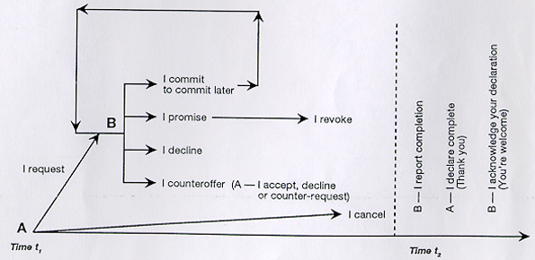
Speech Acts in a Workflow

Slide 13
Organizations
Networks of conversations
Networks of linguistic actions. What do they do?
They produce conditions of satisfaction (not things or specific services)

Slide 14
ActionWorkflow: Five Basic Elements
Customer
Performer
Conditions of Satisfaction
Cycle Time
Observer

Slide 15
The ActionWorkflow Diagram:
Cycle Time
Customer
Conditions of
Satisfaction
Performer

Slide 16
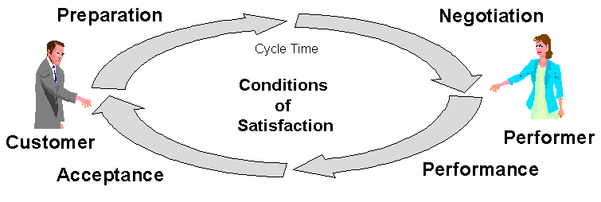
Phases of an Action Workflow Loop
The customer requests (or the performer
offers) completion of a particular work - to
be done by the performer.
The customer and the performer
come to mutual agreement on the
conditions of satisfaction.
The customer evaluates and
declares to the performer that
the completion is satisfactory.
The performer takes necessary actions
and finally, he/she declares to the
customer that the work is complete.

Slide 17
Two Types of Processes
Request
  In a request, a customer makes a request to a performer to produce some conditions of satisfaction by a specified time.
Offer
  In an offer, a performer makes an offer to a customer to produce some conditions of satisfaction by a specified time.

Slide 18
Workflows and
Work Processes (Business Processes)
A Workflow is a representation of commitments that people make in order to produce customer satisfaction.
A Work Process is a set of interrelated workflows in which customers and performers work together to produce customer satisfaction for an external customer.

Slide 19
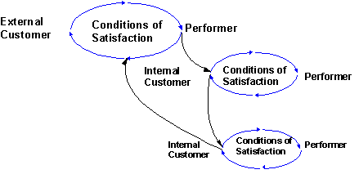
Map of a Work Process (example)

Slide 20
Limitations of Traditional Process Mapping (from an AWF perspective)
Focus on objects, not people
No concerns for negotiations, only decision points (yes/no)
Does not include customer satisfaction in the map/analysis
Does not show the human perspective on work

Slide 21
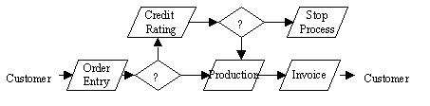
Traditional Process Map

Slide 22
How to Diagnose Workflows according to AWF
??
Conditions of Satisfaction
Performer
Customer
Conditions of Satisfaction
??
Missing or unknown customer
Missing or unknown performer
Customer
Conditions of Satisfaction
Performer
Customer
Conditions of Satisfaction
Performer
Customer
??
Uförare
Missing Preparation Phase
Missing Negotiation Phase
Missing, unspecified or different interpretations of conditions of satisfaction
Customer
Conditions of Satisfaction
Performer
Customer
Conditions of Satisfaction
Performer
Missing Acceptance Phase
Missing Performance Phase

Slide 23
Two kinds of Tools for the Action Workflow Approach
Process Tools: e.g. ActionWorks Process Builder (analysis and design of processes)
Workflow Tools: ActionWorks Metro or applications in e.g. Lotus Notes (monitoring and fulfilment of processes)
http://www.actiontech.com/
Notes:
38

